Slide 1
Final Project
Name: Xiao Liu

Slide 2

Business Problem & Context
Business question: predicting who will not renew in year 3 and through season ticket holder from year 1 who did renew or defect in year 2.
Techniques of data analysis: data visualization, ETL, data wrangling, exploratory data analysis, model building, model selection and evaluation.

Slide 3
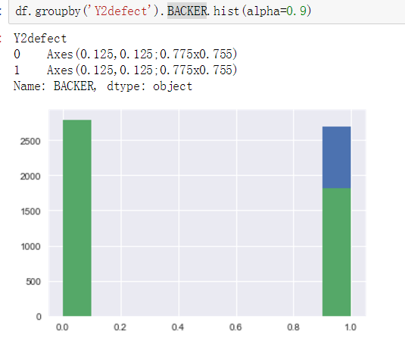
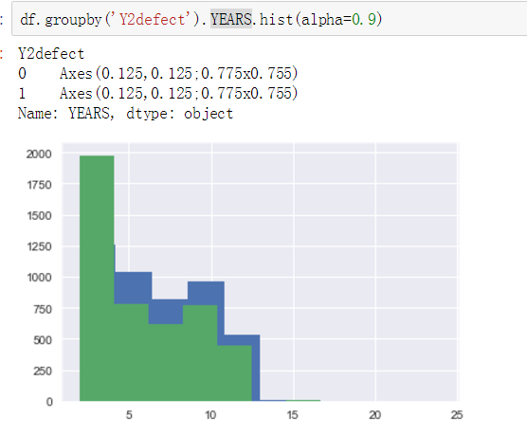
Key finding

Slide 4
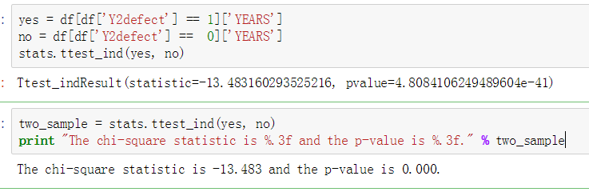
Key finding
The lower the number of years as a season ticket holder, the higher ticket holders that did not renew for year 2

Slide 5
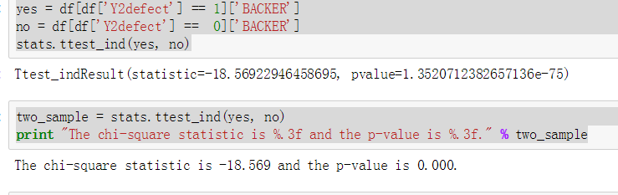
Key finding
Ticket holders who are not a member of the team's "backer" club, the higher chance that did not renew for year 2

Slide 6
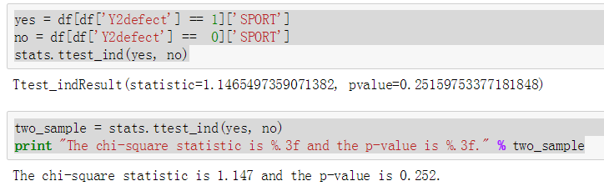
Key finding
There is no significant difference between ticket holders that did renew or not in terms of the sport.

Slide 7
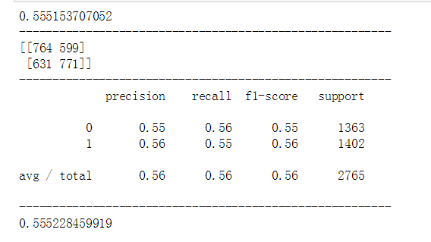
classification model
Best model is Decision tree model
55.5% model accuracy
0.555 AUC score; AUC = Area Under Curve
TPR = (true positives/total positives) = 771/1402= 0.55
FPR = (false positives/total negatives) = 599/1363 = 0.439

Slide 8
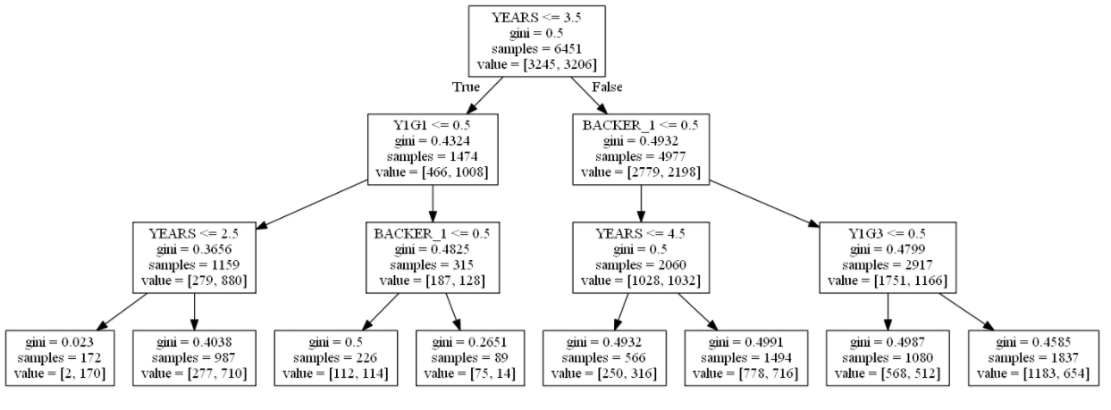
Decision tree model

Slide 9
suggestions and implications
The ticket holder who are member of the team's "backer" club and the long number of years as a season ticket holder will be more renew with season tickets.
The Ticket holders who are not member of the team's "backer" club, and short term the number of years as a season ticket holder is likely to defect.
I recommend K-State Athletic Department season ticket focus who is not a member of the team's "backer" club, and the short term number of years as a season ticket holders that are predicted to be most at risk to defect.

